Slide 1

ABC Limited – Insights Report Sandeep Dubba Sandeep.dubba08@gmail.com 0220416622

Slide 2
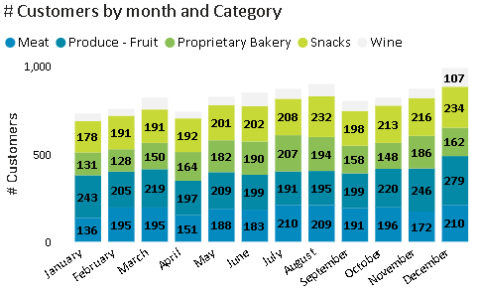
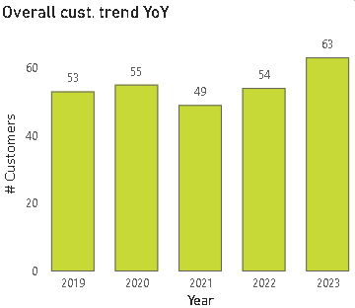
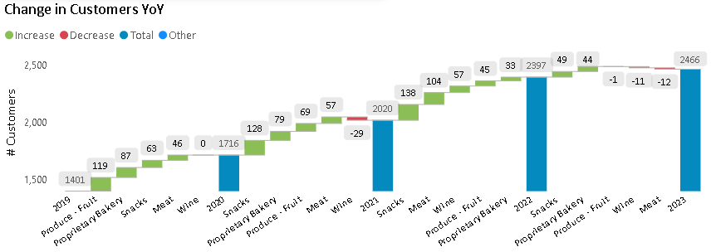
Summary of findings - The top 10 customers account for 50.71% of total sales
Customer Analysis Overview:
The top 10 customers account for 50.71% of total sales, with the leading customer (20078714) showing the highest contribution in 2023, increasing purchases from $268 in CY21 to $1,119.70 in CY23A, mainly from meat sales.
Seven customers reported negative sales in CY23A due to returns, discounts, cancellations, or promotional activities.
Customer buying pattern
Customer buying patterns peak in March, August, and December.
In March, sales rise due to the harvest season, Waitangi Day, Easter, and school reopenings.
August sees an increase in demand for comfort foods due to winter and is bolstered by sales promotions.
December benefits from Christmas festivities, gift-giving, and tourism, driving up sales.
Conversely, April experiences a sales dip following Easter, and September sees lower sales due to a lack of significant holidays, spending fatigue, and reduced tourism.
Customer movement between CY19 to CY23
From CY19 to CY23, the number of customers consuming Produce – fruit category products declined, partly offset by increased snack consumption.
Wine customer numbers fell between 2020 and 2021 due to COVID-19, with spending shifting to essentials.
This trend continued into CY23 with declines in wine and meat consumption due to high inflation and living costs.
Bananas were the top-consumed product during this period.
The total number of customers dropped by 11% in CY2021 compared to CY2020 because of COVID-19 but recovered to pre-COVID levels in 2022.

Slide 3
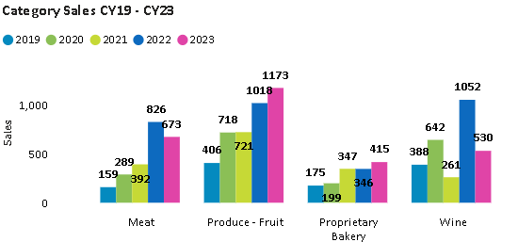
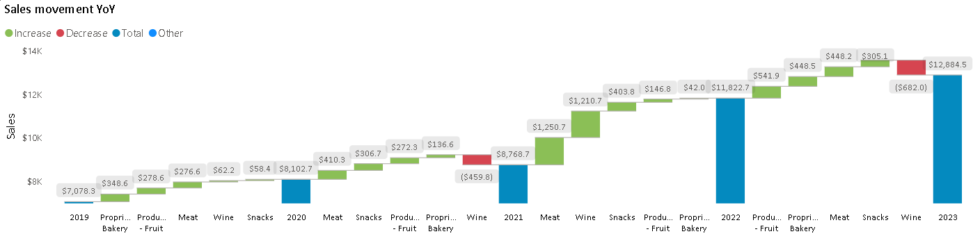
Summary of findings – ABC Ltd. Sales Data Shows Robust Growth in Produce and Bakery Sectors Amid Volatile Trends in Meat and Wine from 2019 to 2023
Product Analysis Overview:
There was robust overall growth from 2019 to 2022, with a peak in sales in 2022 followed by a decline in 2023. The growth in early years could be attributed to market expansion or increased consumer spending.
Product Category Analysis
There was a substantial increase in Meat sales from 2019 to 2022, peaking in 2022. This could be due to increased demand for meat products or possibly supply chain improvements.
Produce - Fruit has shown consistent growth, indicating a strong consumer preference for fresh produce. This suggests that fruits are becoming a larger part of the consumer basket, possibly due to health trends.
Wine sales showed high volatility, with significant increases and decreases year-over-year. The large increase in 2022 followed by a substantial decrease in 2023 could be due to high inflation or changes in consumer drinking habits.
Significant growth in Proprietary Bakery was observed from 2019 to 2021, followed by a slight decline in 2022 and a rebound in 2023.The fluctuations could be due to changing consumer preferences.
Change in sales YoY
Consistent Growth in Produce - Fruit and Bakery: Both categories have steadily increased year-over-year due to health-conscious consumers and the popularity of fresh and organic foods.
Fluctuations in Wine Sales: Wine sales have been volatile, with significant drops in 2021 and 2023 likely due to changing consumer preferences, economic factors, or increased competition.
Strong Performance in Meat and Snacks: Meat and Snacks have shown consistent annual growth, likely driven by stable demand, promotions, product quality improvements, and broader assortments.
Economic and Market Dynamics: Overall sales growth in 2022 and 2023 is likely influenced by post-pandemic economic recovery, increased consumer spending, and strategic company initiatives.

